Slide 1
Introduction to Handle with Care
Introduction to SafeVoice/ Handle with Care

Slide 2
SafeVoice Contacts
Peggy Edwards
SafeVoice Coordinator
safevoiceinfo@doe.nv.gov
Don Johnson
Field Representative
775-267-7796
Sgt. Desiree Mattice
775 684-2587
775 301-0961 cell

Slide 3
What is SafeVoice
SafeVoice and Handle with Care
SafeVoice receives tips and sends them to Law Enforcement and/or the School Handle with Care (SafeVoice) receives tips from Law Enforcement and sends the information to the School for them to follow-up (Handle with Care tips: notification of a traumatic event that occurred in the presence of a child)

Slide 4
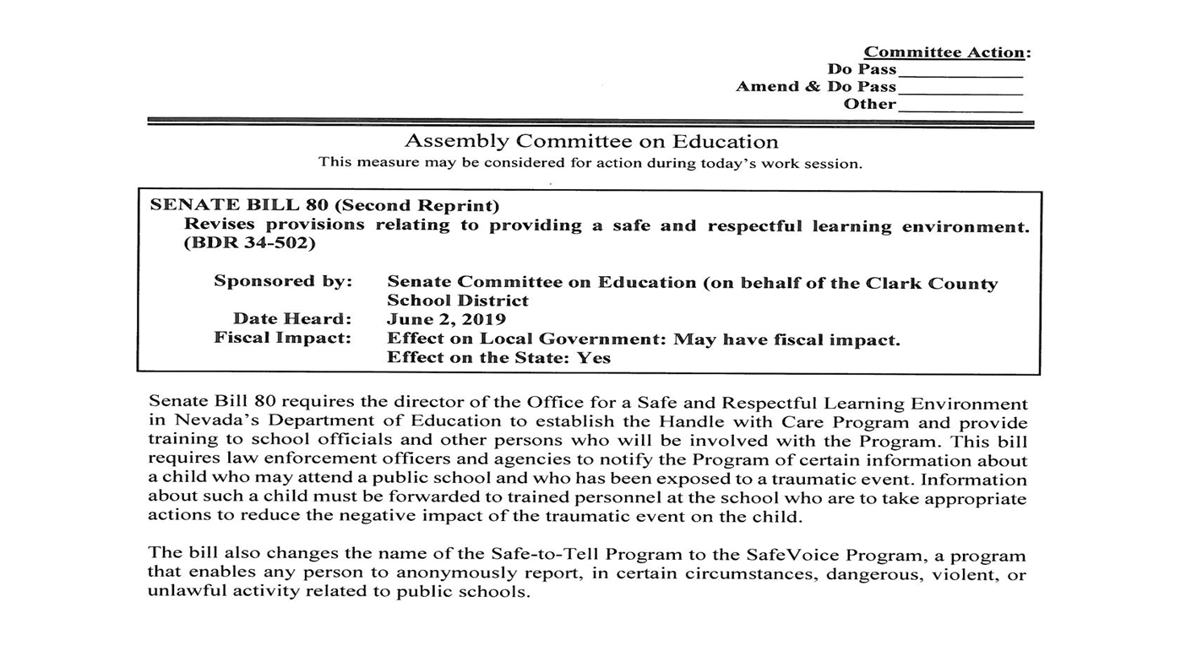
Senate Bill 80
SB 80: Handle with Care Program

Slide 5
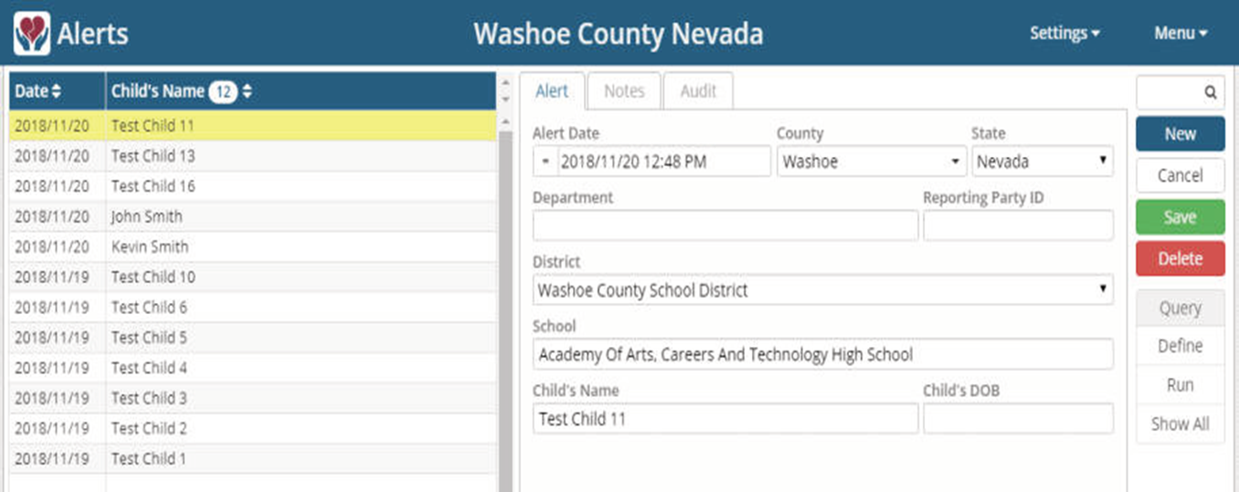
Handle with Care Alerts on the SafeVoice System
Handle with Care Alert on the SafeVoice System:
EFFECTIVE JANUARY 1, 2020: Any Officer or an employee of a law enforcement agency, who in his or her professional or occupational capacity, knows or has reasonable cause to believe that a child who may attend a public school has been exposed to a traumatic event shall submit a report to the Handle with Care program.

Slide 6
SB 80: What are Traumatic Events?
SB 80
Traumatic events include, but are not limited to:
Domestic violence in the presence of the child;
Death of a member of the family or household of the child;
Arrest of a parent or guardian of the child in the presence of the child;
Child abuse or neglect

Slide 7
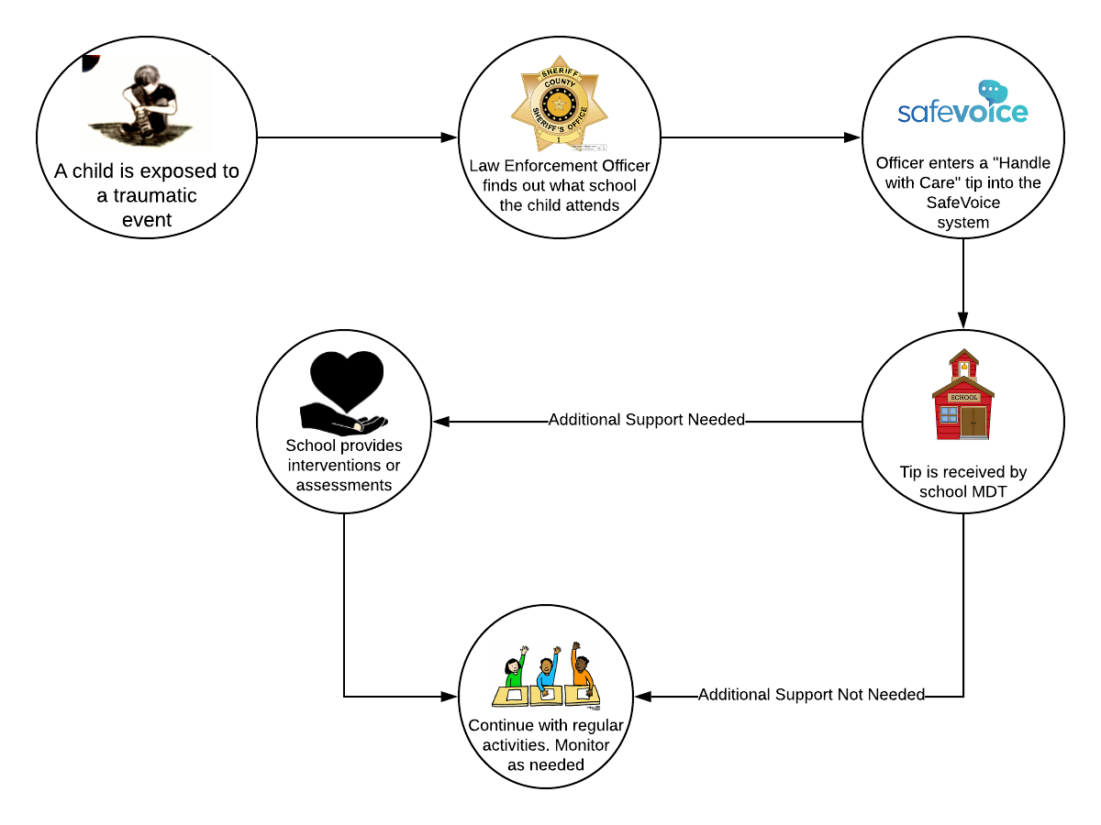
Handle with Care Process
Handle With Care: School Process Flow Chart

Slide 8
Reminders about using SafeVoice
A reminder about the proper use of SafeVoice
Please reinforce these points as you educate about SafeVoice
SafeVoice is here to:
It is not for:
Protect students from bullying and school violence
Help students speak up for their friends & themselves
Help parents who have already spoken directly to teachers and principals, yet feel they have not been heard
False reports, peer conflict, or pranks
Complaints and grievances that are not related to school safety and student well-being
Harassing other students or adults in the school
These take life saving time from the Comm Center
False and malicious reporting can cause reporter to void anonymity

Slide 9
Questions?
Questions?
For more information about SafeVoice, please contact:
Don Johnson, Field Representative, SafeVoice
775-267-7796 cell Leave message
djohnson.safevoice@gmail.com
Desiree Mattice, Sergeant, SafeVoice Communication Center Director
775 684-2587 / 775 301-0961 cell
dmattice@dps.state.nv.us
Communication Specialist Supervisor Desk:
775 684-2583
SVNV@dps.state.nv.us

